Slide 1
What makes a good
red wine?
Using Random Forest

Slide 2
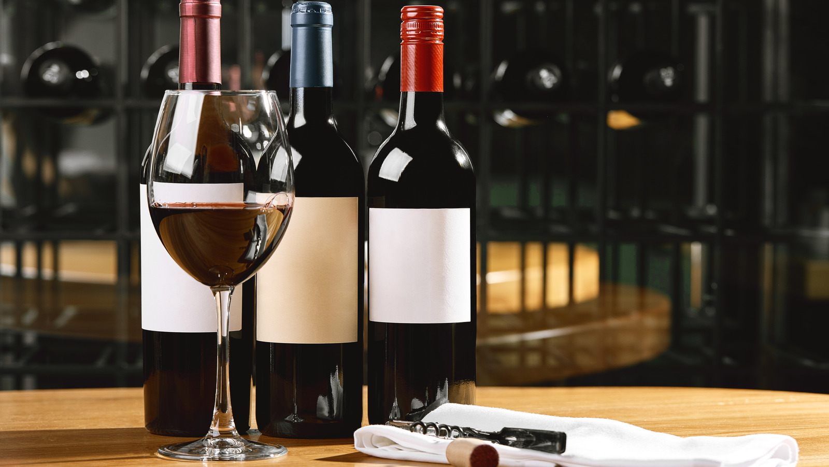
What makes a good red wine?
Price?
Food you eat it with?
Color?
What do you think?
Notes:
We’re all students, i would hardly believe you if you tell me you’ve never tried red wine in you entire life

Slide 3
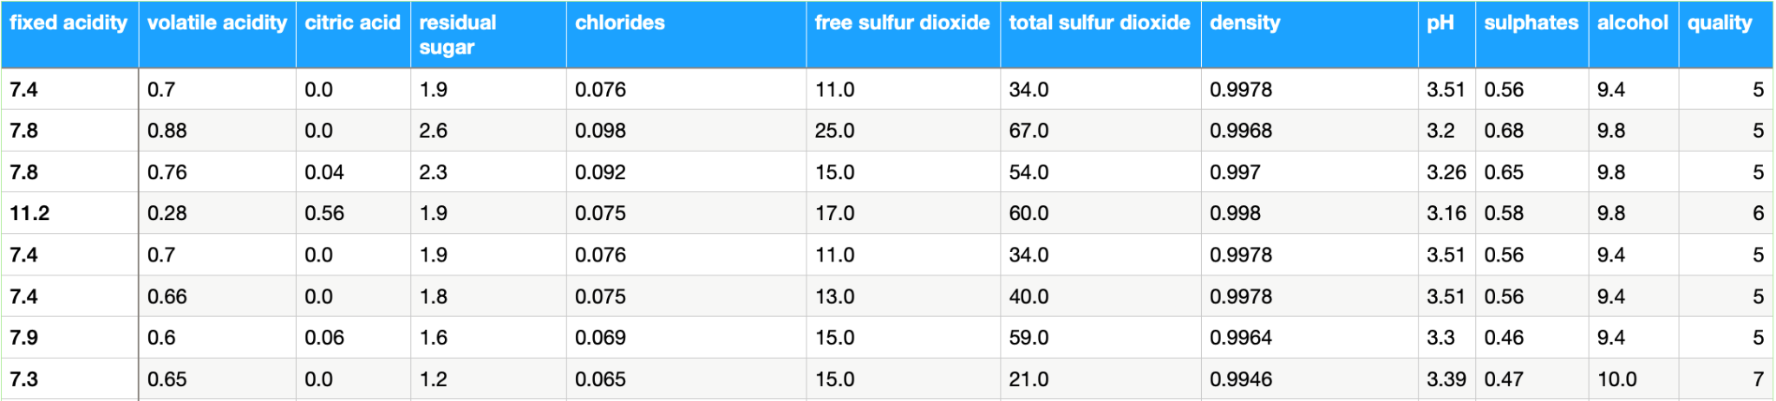
Dataset
Target Variable: quality
Features: fixed acidity, volatile acidity, …, alcohol
Simplify: only good (> 6.5) and bad wine (<6.5)
Type: feature selection
Cortez et al., 2009, Viticulture Commission of the Vinho Verde Region(CVRVV)

Slide 4
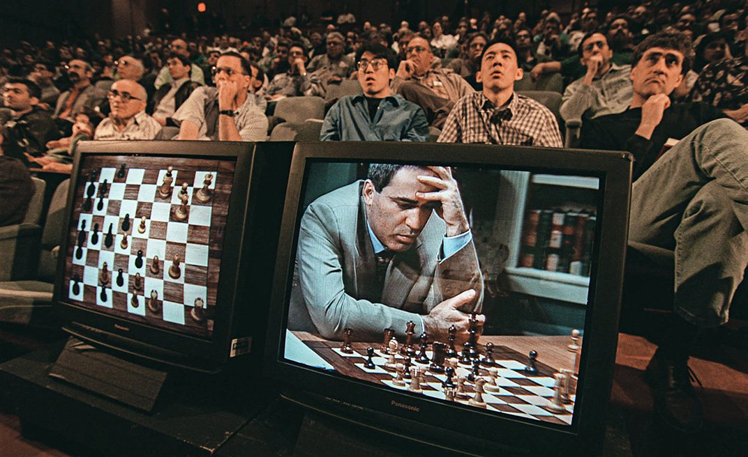
Context: wisdom of the crowd
Intuition: a crowd of individuals is more often right than one single expert
1907: The first scientific study (Francis Galton)
Kasparov vs. the World: Most mediatic experiment

Slide 5

Feature Selection
Goal: Find a subset of features that produces better models for a dataset
Consequences:
Simplification of models
Shorter training times
Improve accuracy for a specific learning model

Slide 6
How would you solve it?
Decision Tree?
Sum of all features?
Sort the alcohol feature?

Slide 7

Random Forest: General idea
Step by step
Creates multiple decision trees on a dataset
Aggregates predictions from each tree
Selects the best prediction by voting

Slide 8
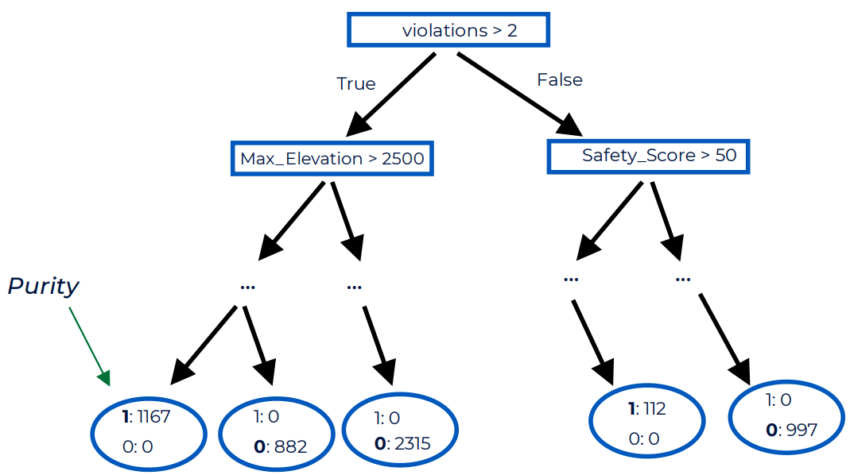
Reminder on Decision Trees
Tree
Gini impurity
Classification & Regression

Slide 9
Random Forest: 2 criteria
Diversity
Accuracy
Need diversity in the prediction of each tree
If every tree has the same prediction, aggregating is useless
Every tree needs an accuracy over 50%
otherwise the collective accuracy will tend to 0% and not 100%

Slide 10
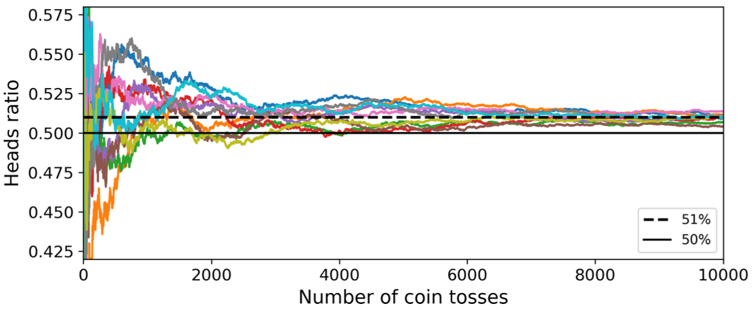
Visualise accuracy >50%
Notes:
there are a sufficient number of weak learners and they are sufficiently diverse
Biased coin with 51% of coming heads and 49% of coming tales
If you toss it 1000 times you’ll have a 75% chance of having a majority of heads, and 97% if you toss it 10,000 times
Graphic of this process being done with 10 series of a biased coin

Slide 11
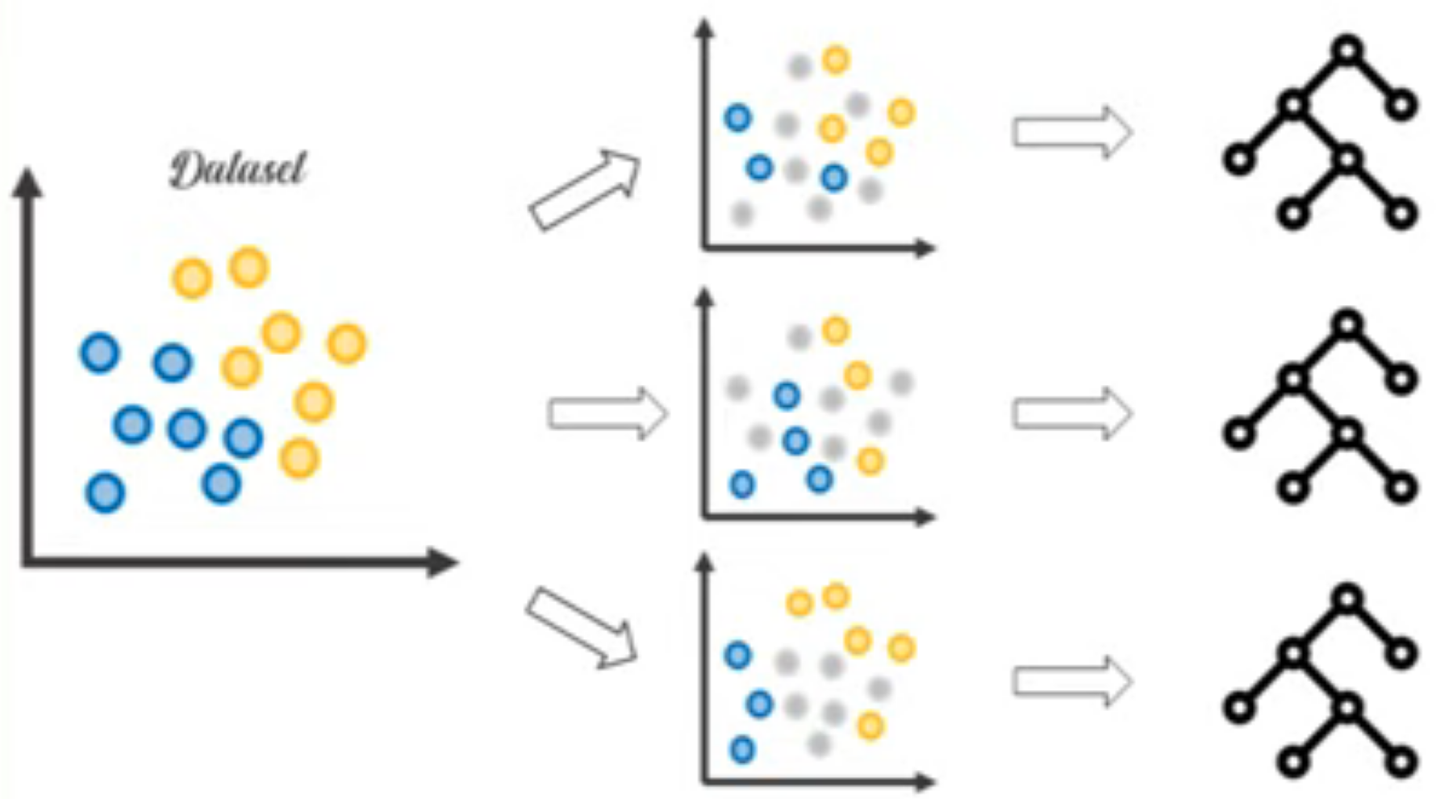
Random Forest: How to create diversity?
Technique: Bagging
Concept:
train each tree on a random subset from the training set
We pick features randomly
Consequence: Different datasets, but common information

Slide 12
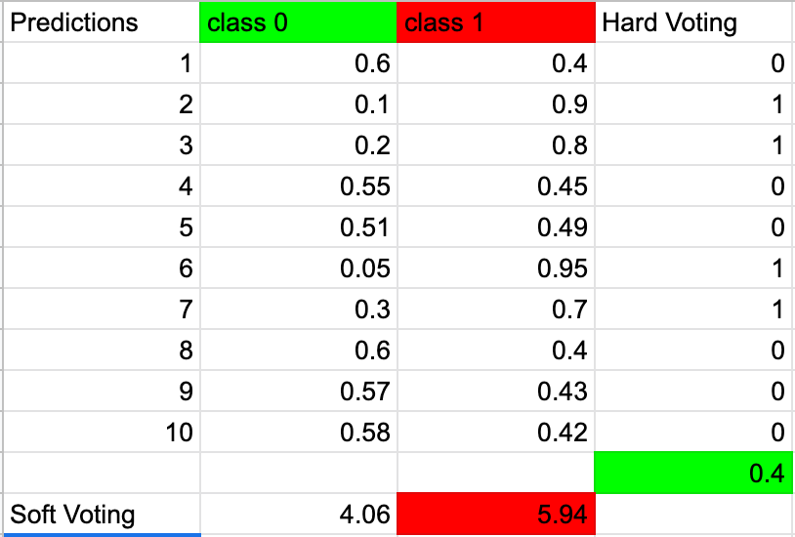
Random Forest: Voting
2 main types of voting (classification)
Hard: vote by majority
Soft:
vote from the sum of the probabilities of each class
Often better performance

Slide 13
Why Random Forest outperforms a Decision Tree?
⇒ Solves the 2 biggest problems of DTs
Too deep tree: it might memorizes the noise of the training data and fails to select the important features
Too short tree: with not enough information, your tree will just under perform
We will cover these concepts in the next workshop

Slide 14
🚀 Back to the problem… Demo! 🚀
Link: http://localhost:8888/notebooks/rf-ai-society.ipynb

Slide 15
Kaggle challenge

Slide 16
Today’s Maths
Decision Tree
Maths
Today’s Maths

Slide 17
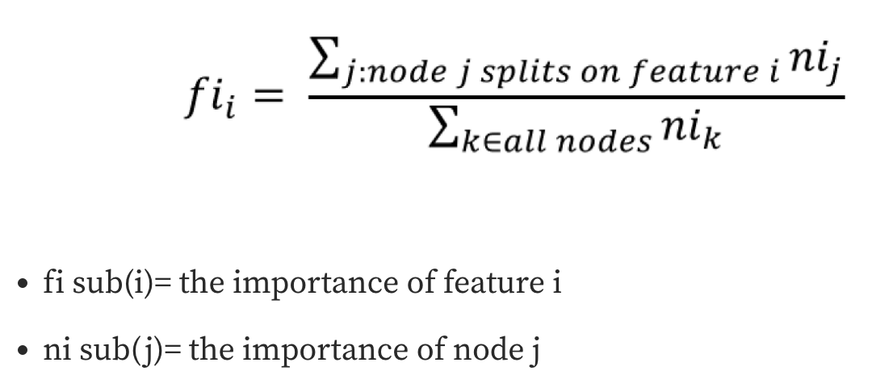
For the Math lovers: Feature importance

Slide 18
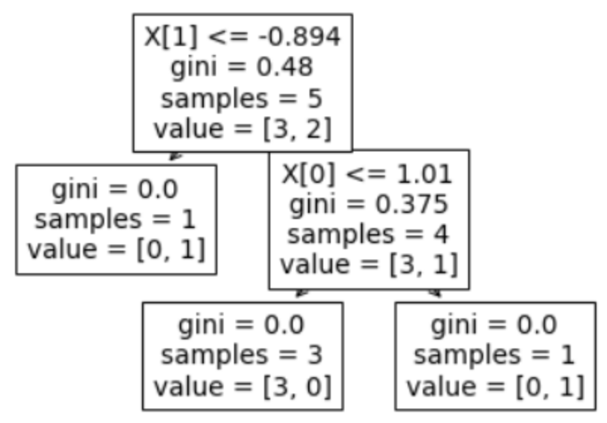
For the Math lovers: Nodes importance
N sub(t): number of rows that node has
N: total number of rows in the current data
impurity: gini index value
N sub(t(right)): number of nodes in right node
N sub(t(left)): number of nodes in left node
Notes:
5 rows and 2 columns for simplicity

Slide 19
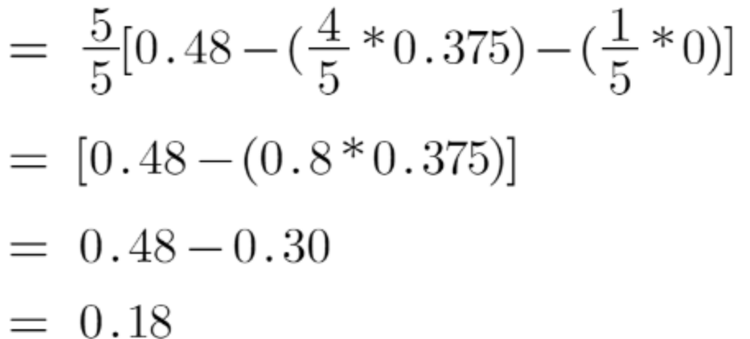
For the Math lovers: Calculation for Node 1

Slide 20
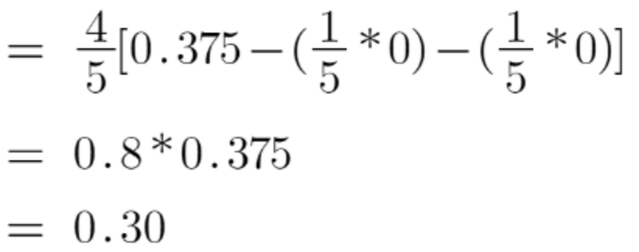
For the Math lovers: Calculation for Node 2

Slide 21
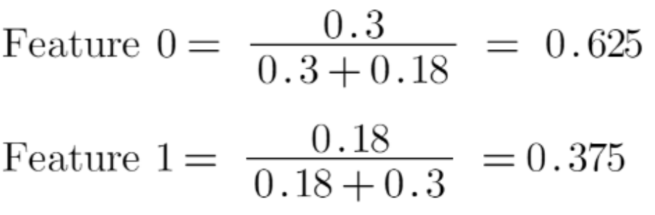
For the Math lovers: End of the story

Slide 22
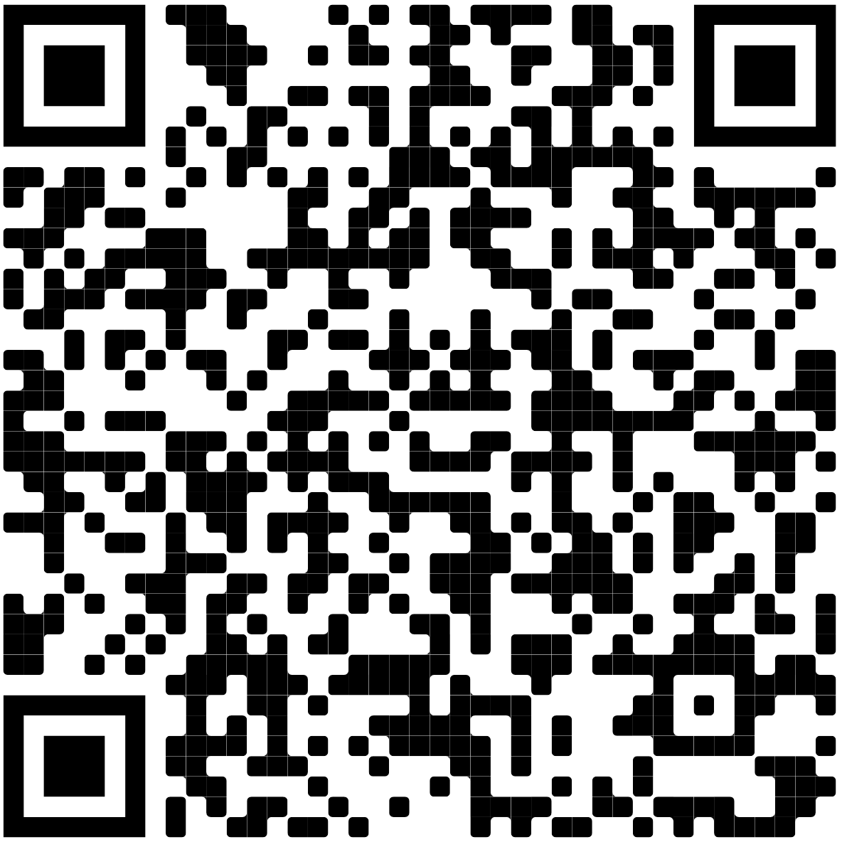
Survey time!

Slide 23
Next event

